Slide 1
Sales Analysis for Ecommerce Store
Presented By : Samarth Saxena

Slide 2
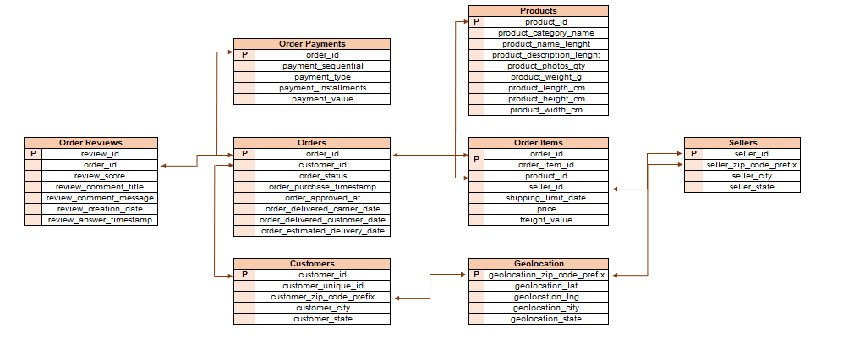
Data Overview :

Slide 3
Points for Analysis :
Create the different metrics like Sales, customer acquisitions, total no. of orders for each Year across the different states they serve.
Using the above metrics, identify the top 2 States which show
Declining trend over the years
Increasing trend over the years
For the States identified above, do the Root Cause analysis for their performance across a variety of metrics.
Category level Sales and orders placed, post-order reviews, Seller performance in terms of deliveries, product-level sales & orders placed,
% of orders delivered earlier than the expected date, % of orders delivered later than the expected date, etc.
Do the above analysis for the top 2 cities which are causing the trend for each of the states identified in point (b)
After doing the Root cause analysis, help the client by suggesting ways to improve the performance of the States and the cities

Slide 4
Introduction :
We have a provided with the data about Ecommerce Store and now we have to analyse the data to help the owner see, how to increase number of sales in different states and cities.
We have 99,441 customers for whom we have to perform sales analysis.
Also we have 3095 sellers for these customers which are selling goods either from the same state as customer or sending it from different state.
We have given 32951 different products, in different categories.
Apart from that we also have details of orders and reviews about the service provided by the seller.

Slide 5
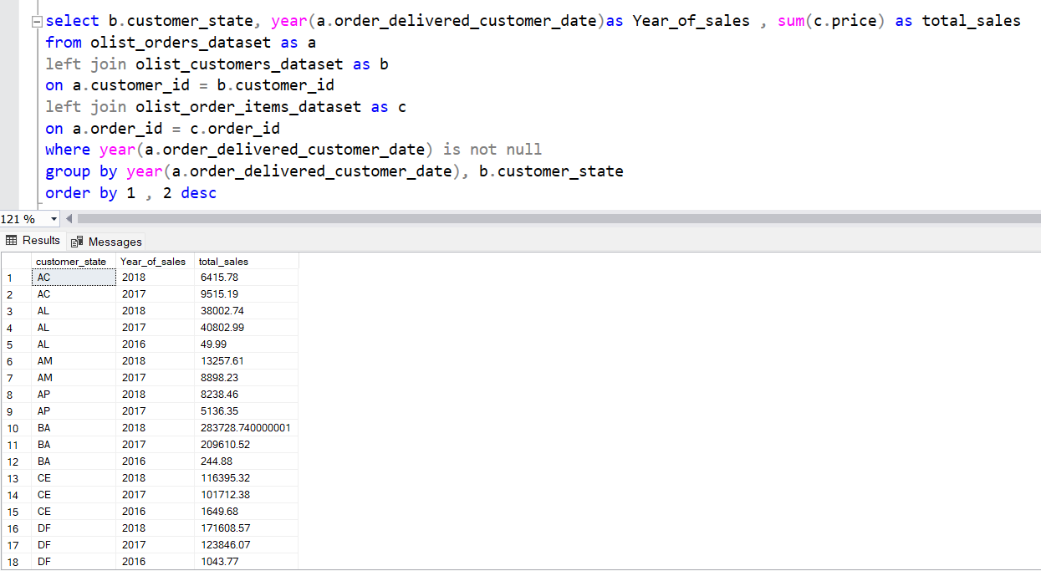
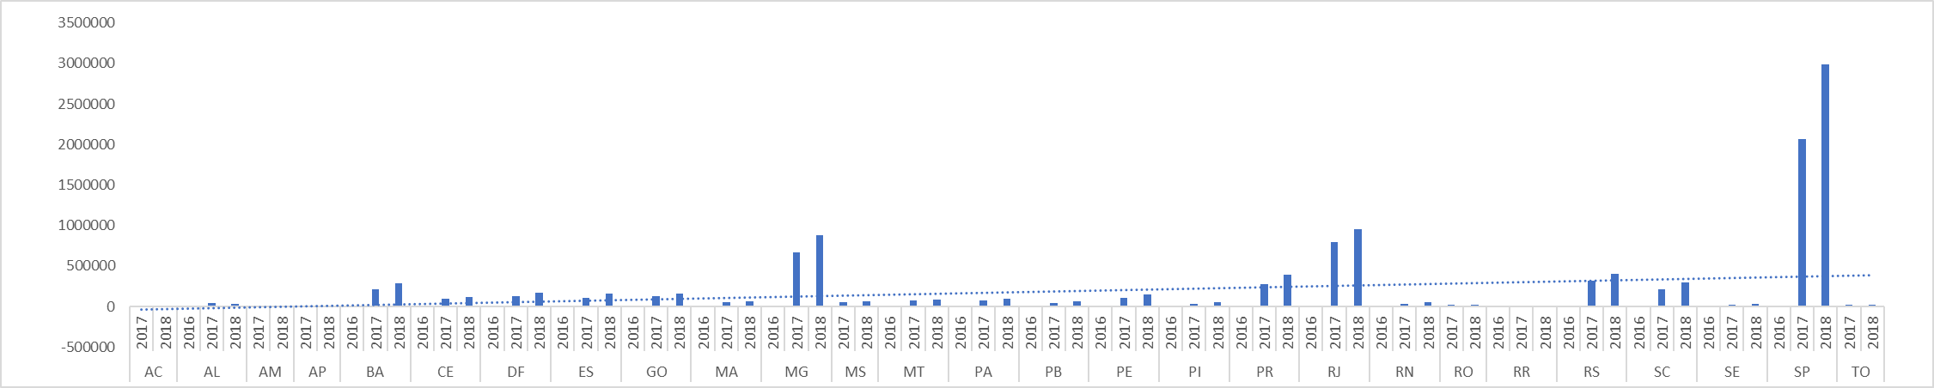
Total number of Sales for each Year across the different states they serve :

Slide 6
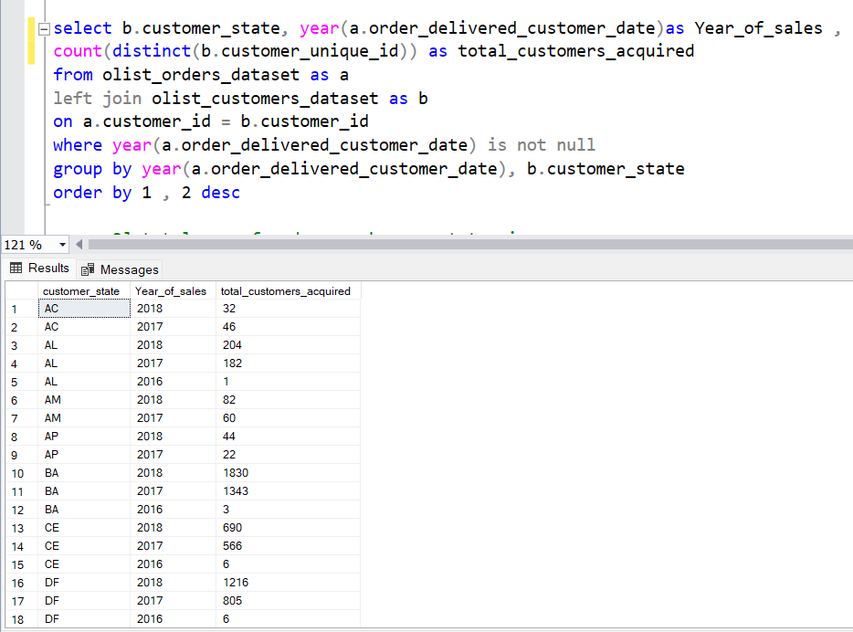
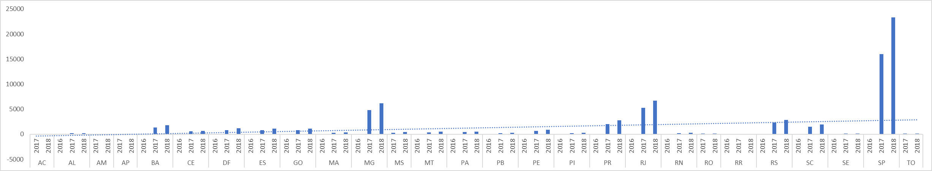
Total number of Customers Acquired for each Year across the different states they serve :

Slide 7
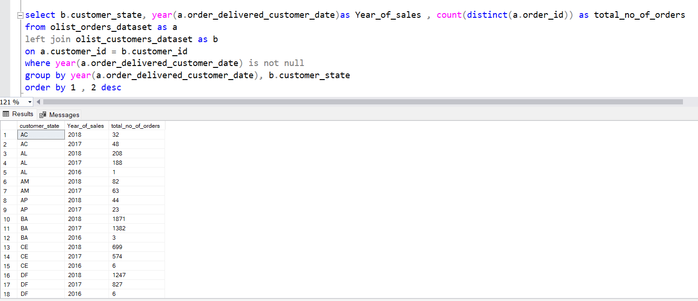
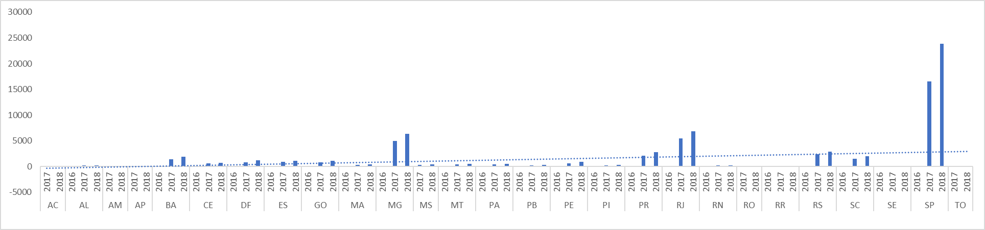
Total number of Sales for each Year across the different states they serve :

Slide 8
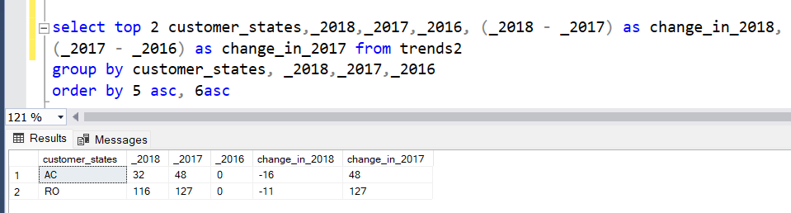
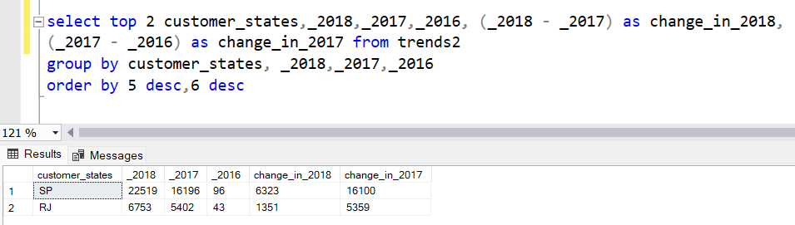
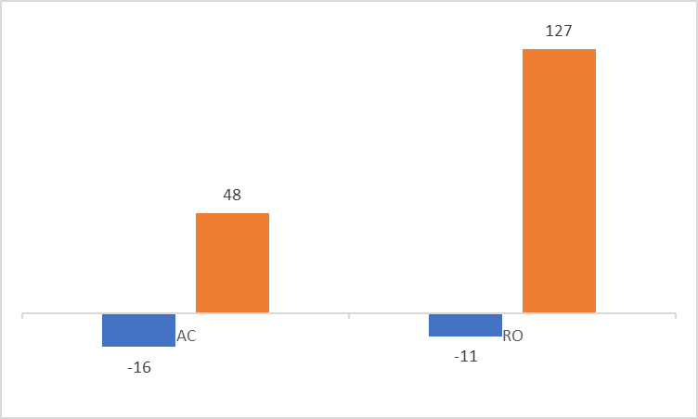
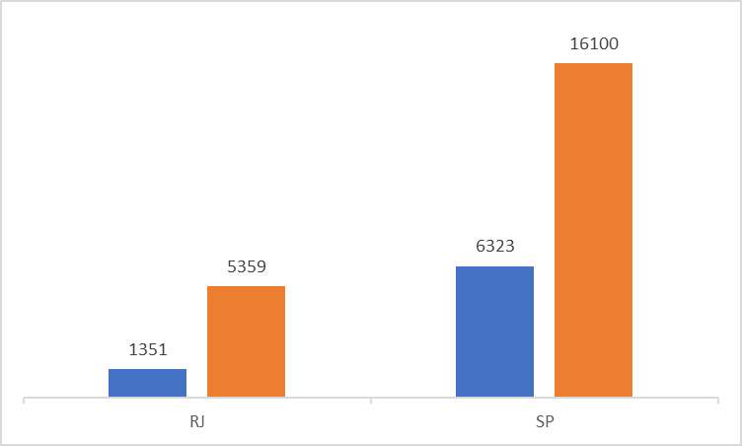
Using the above metrics, identify the top 2 States which show Declining and Increasing over the years :

Slide 9
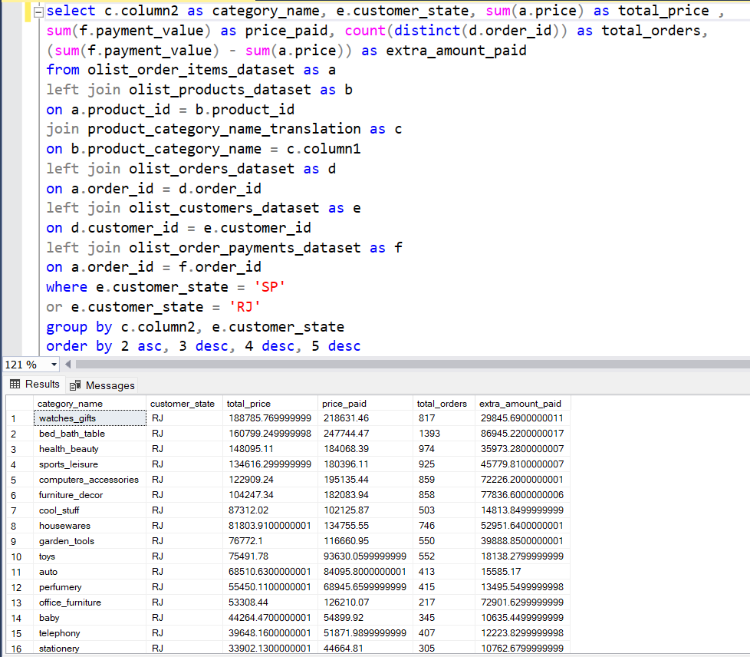
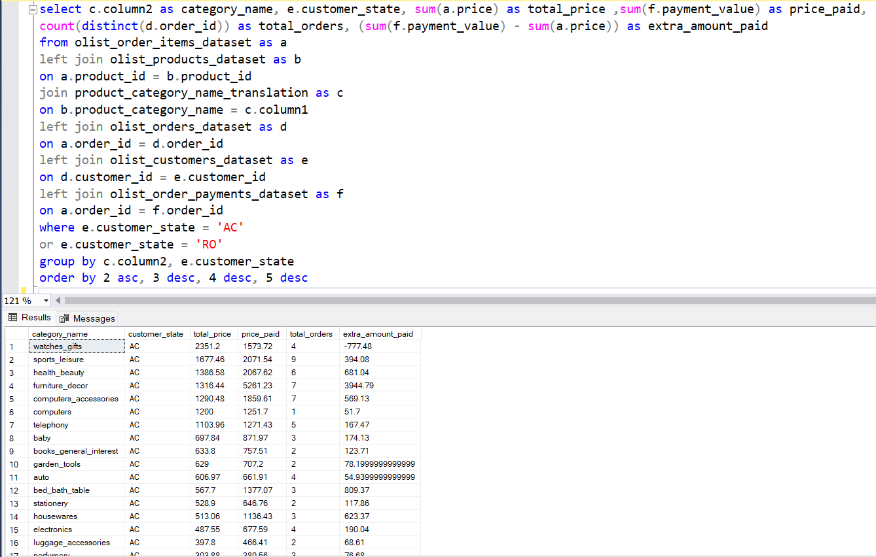
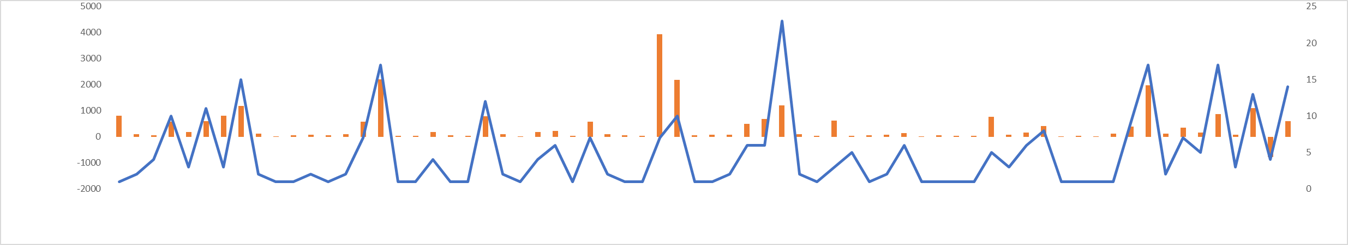
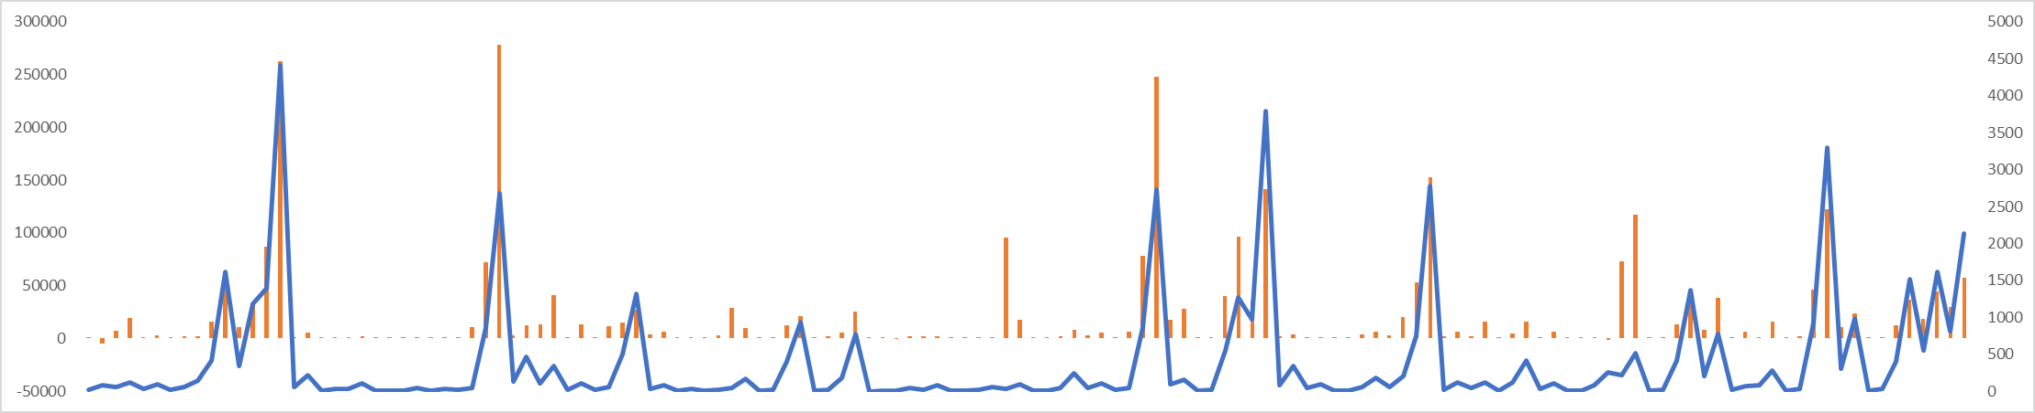
Category Level Sales and Orders Placed for trending states :

Slide 10
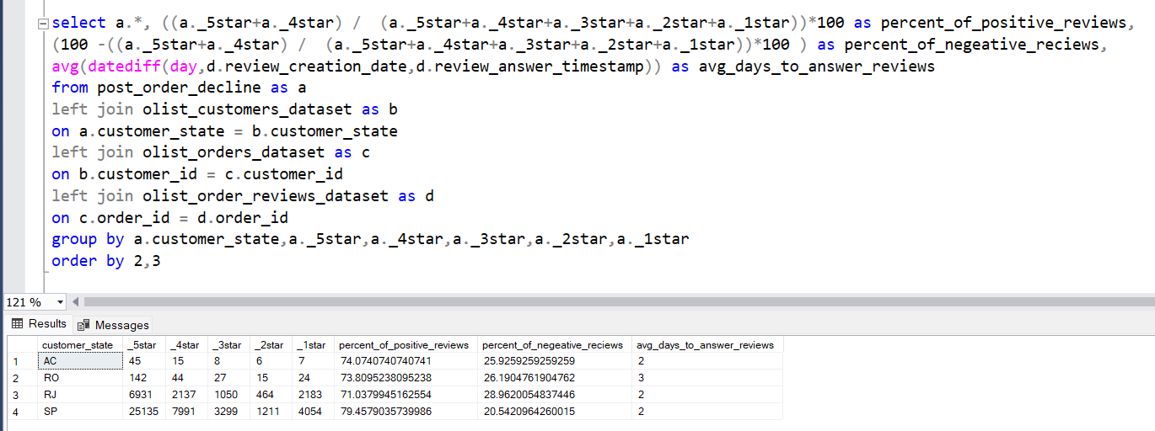
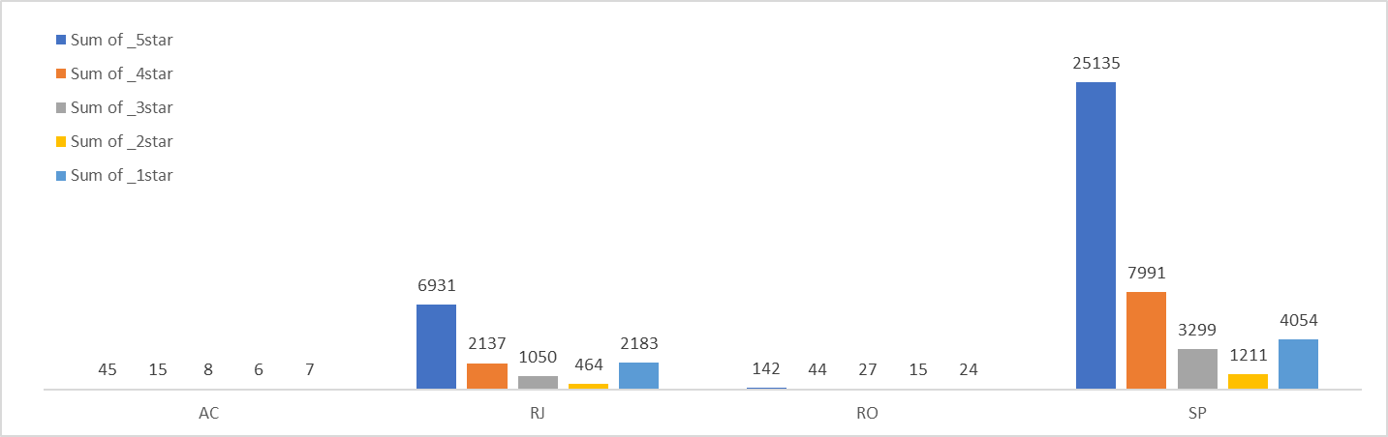
Post Order Reviews for the trending states :

Slide 11
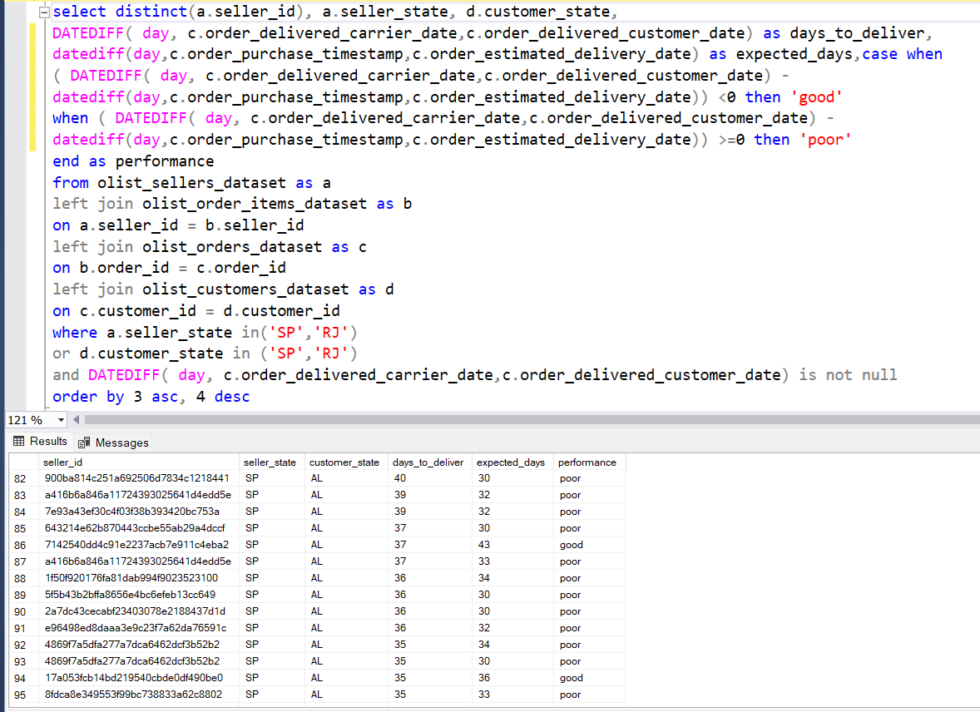
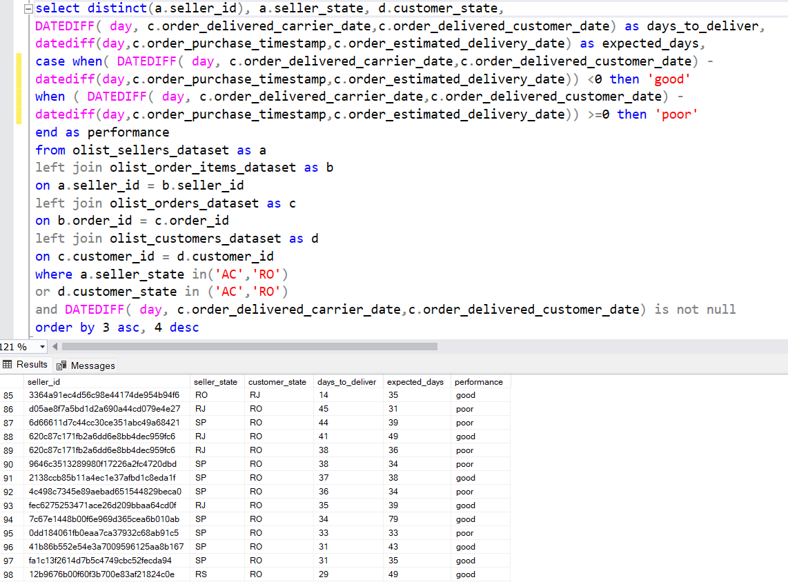
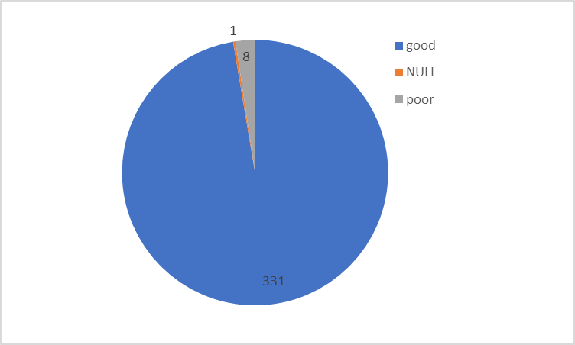
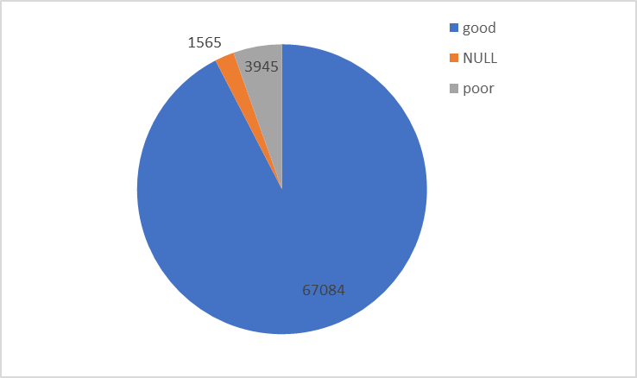
Seller Performance in terms of deliveries for trending states :

Slide 12
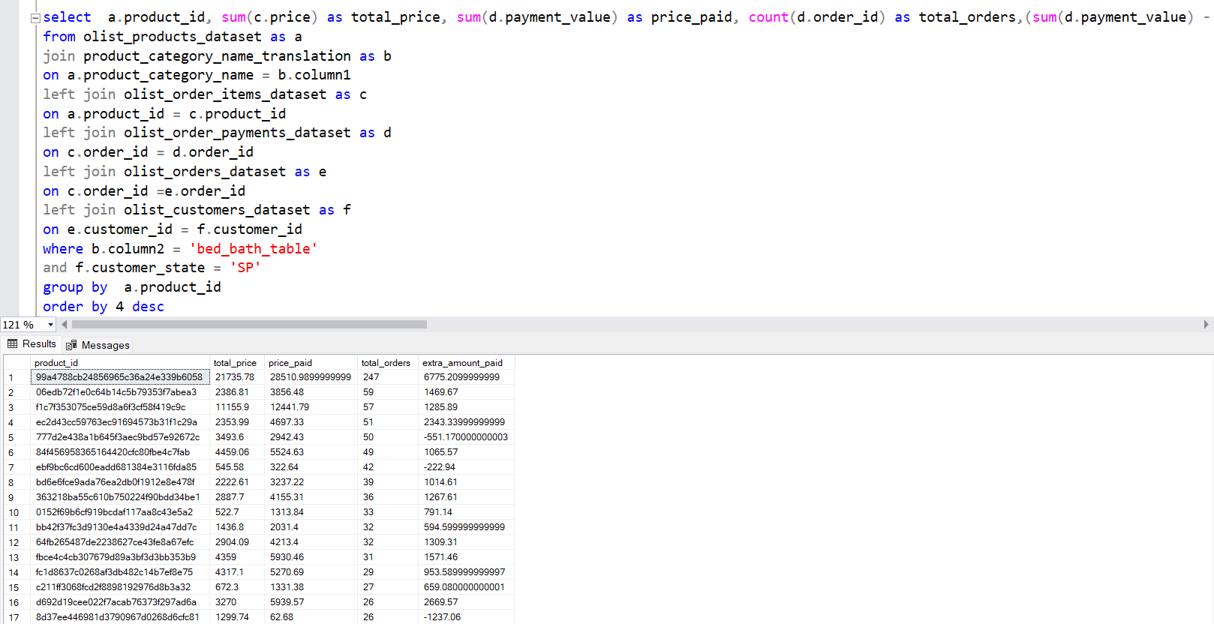
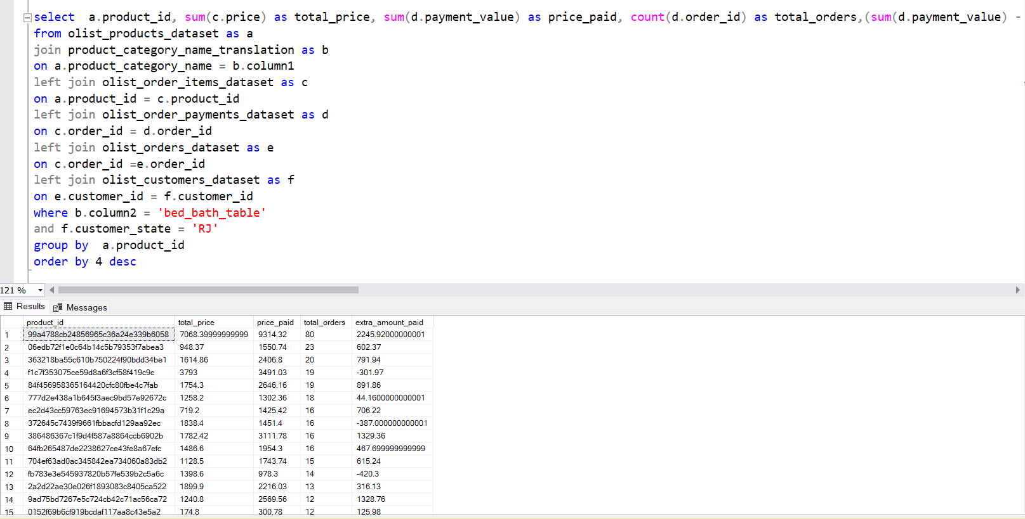
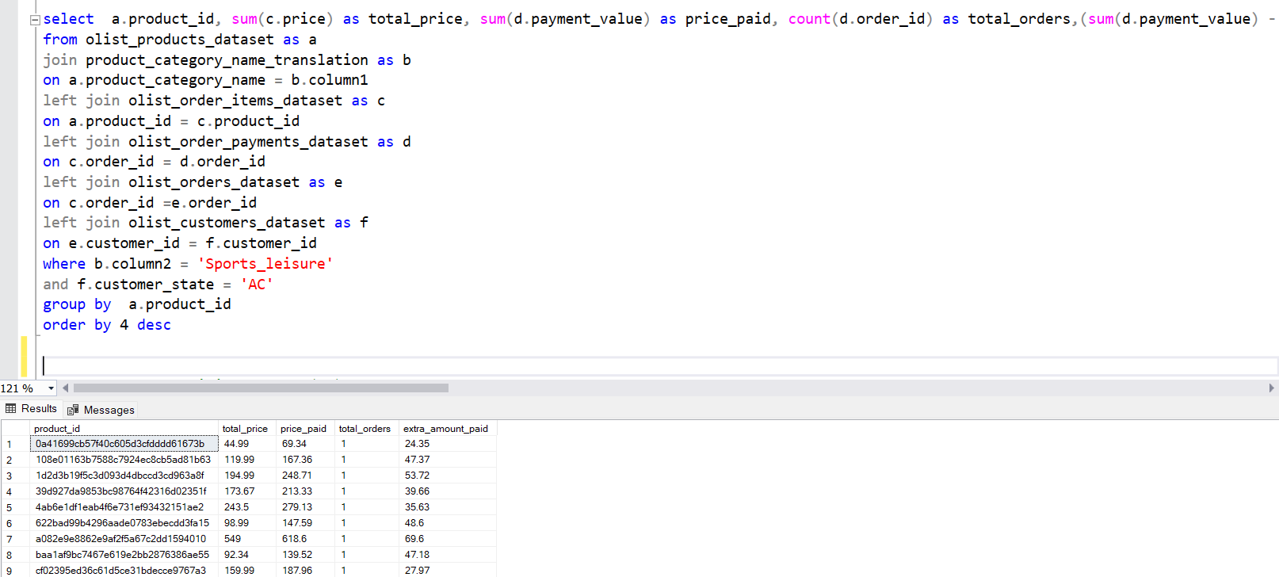
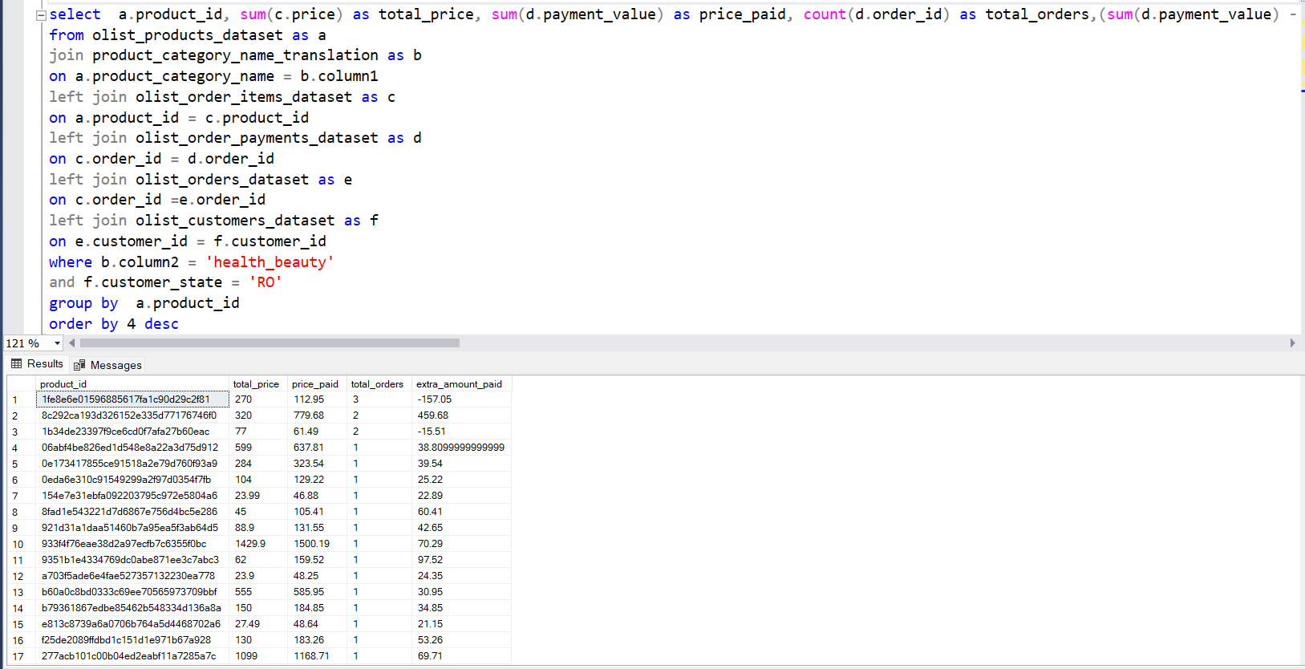
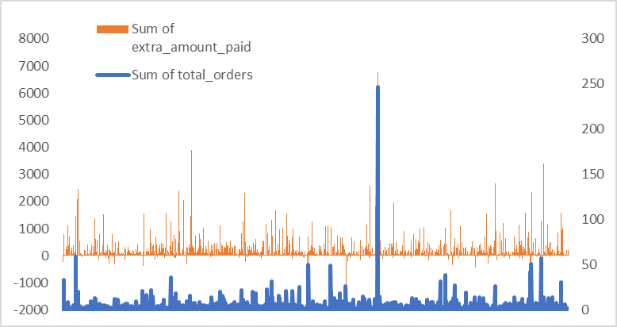
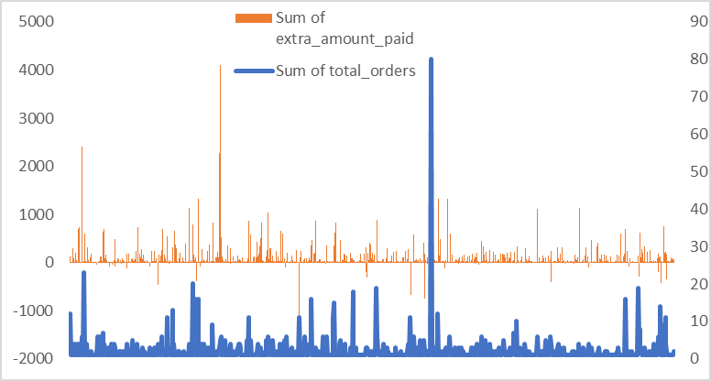
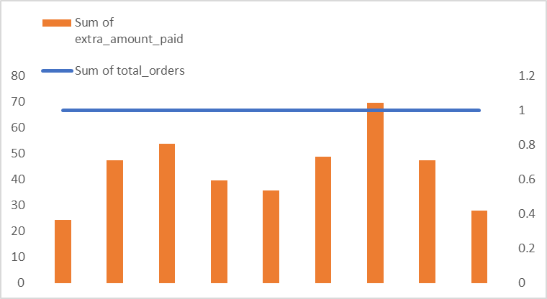
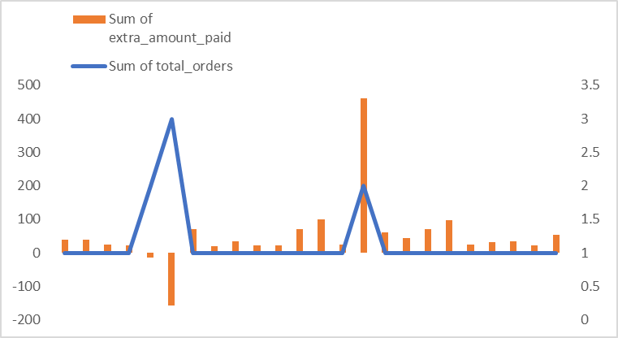
Product level sales and orders place for trending states :

Slide 13
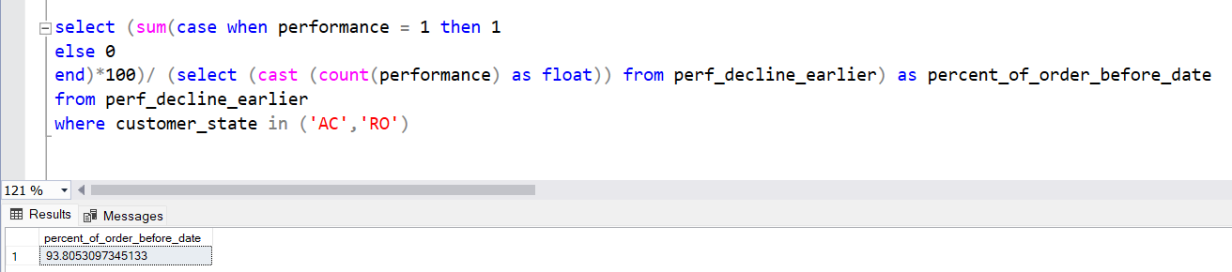
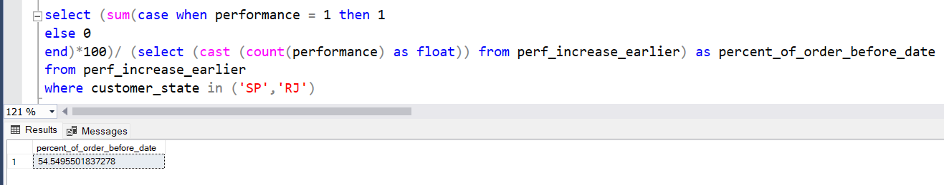
% of order delivered earlier than expected date :

Slide 14
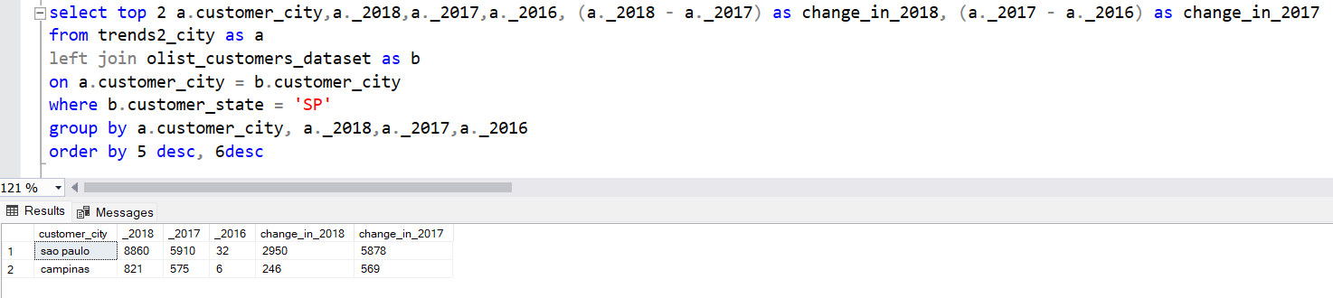
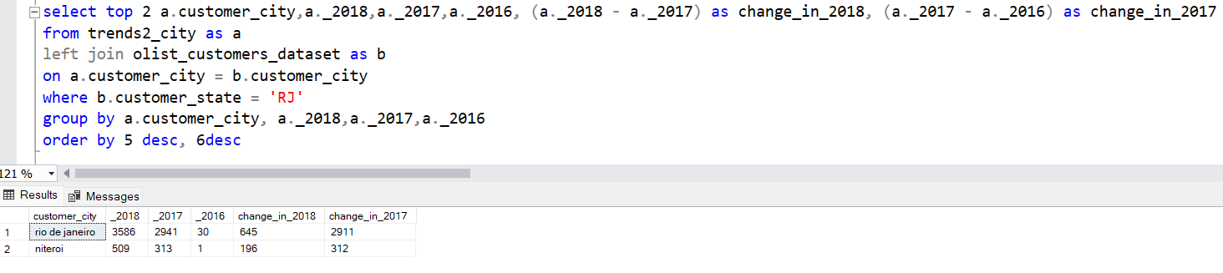
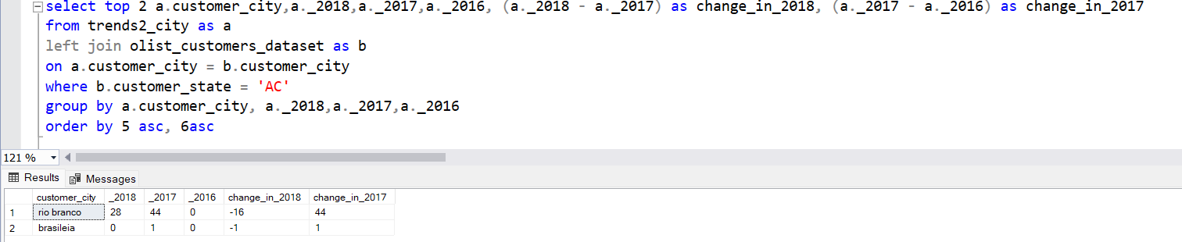
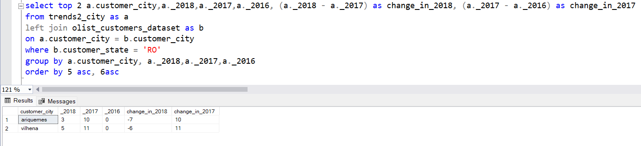
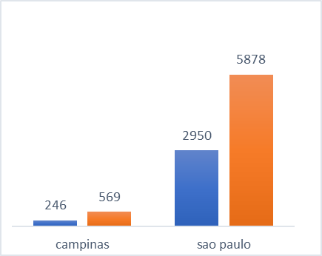
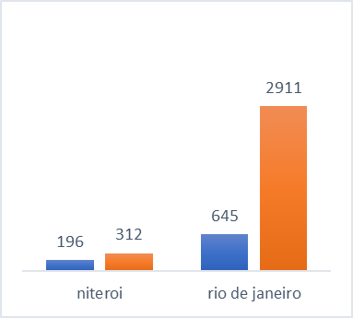
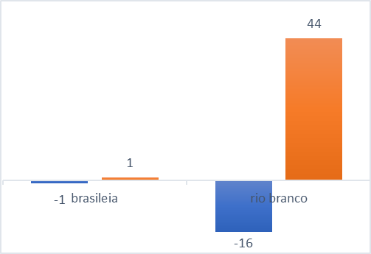
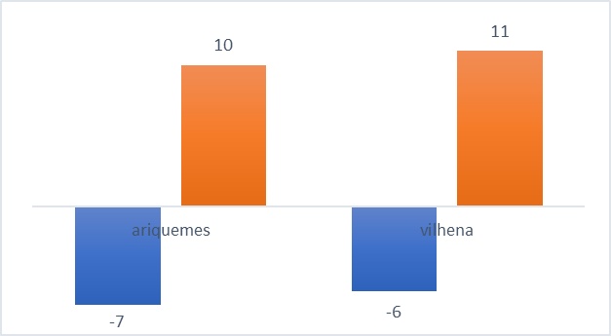
Top 2 cities for each trending state which are causing the trend :

Slide 15
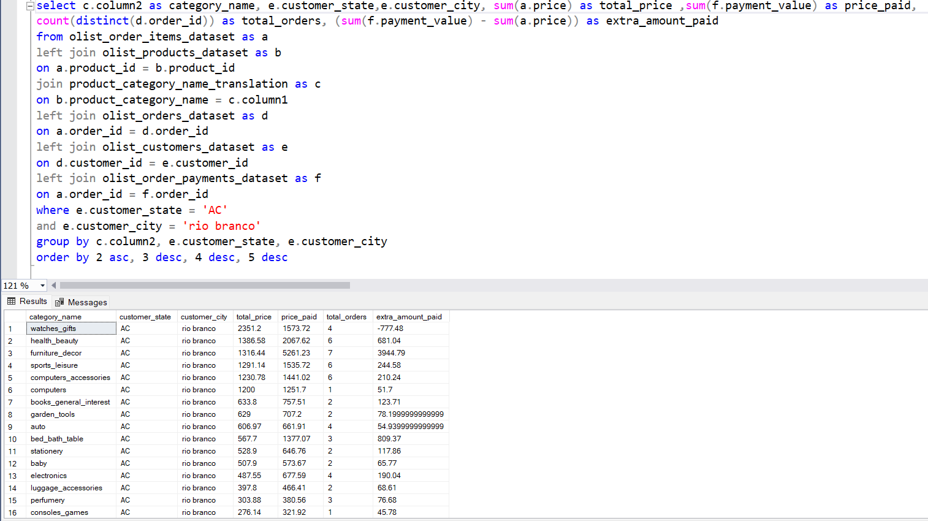
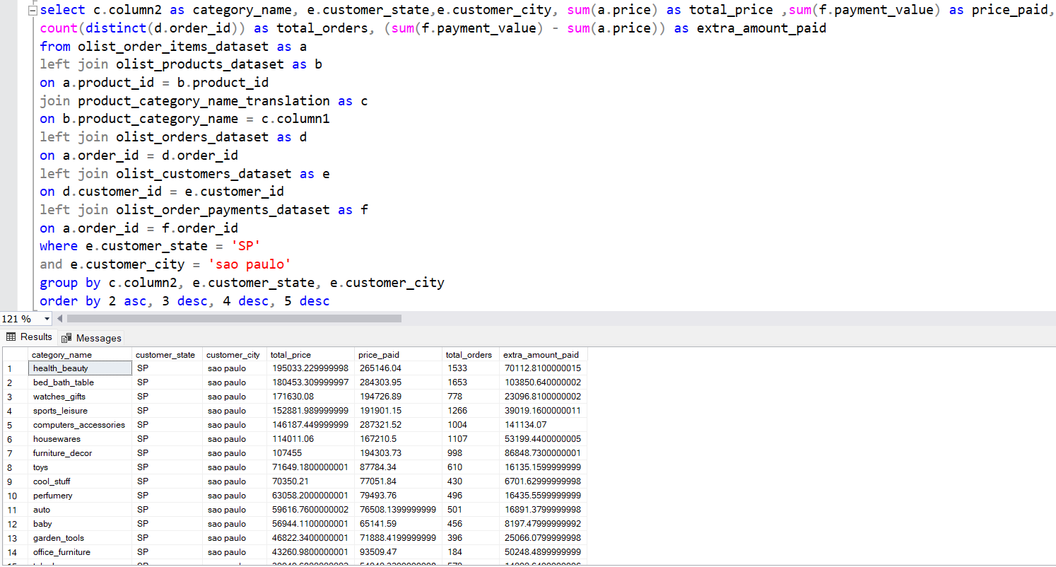
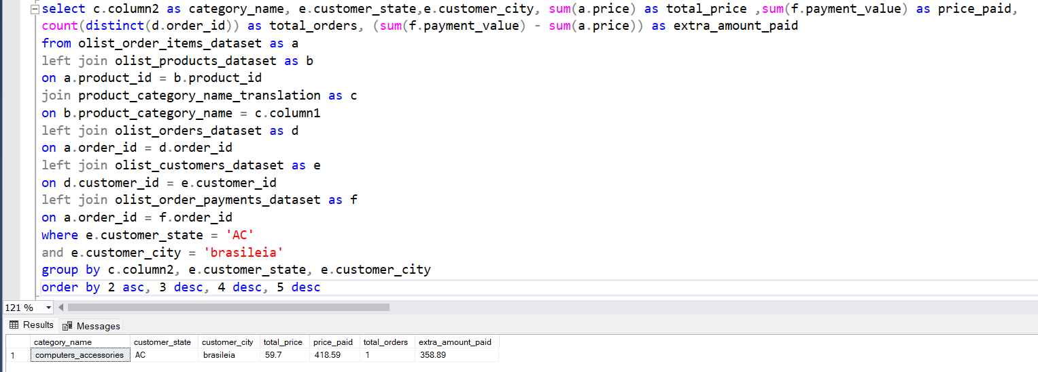
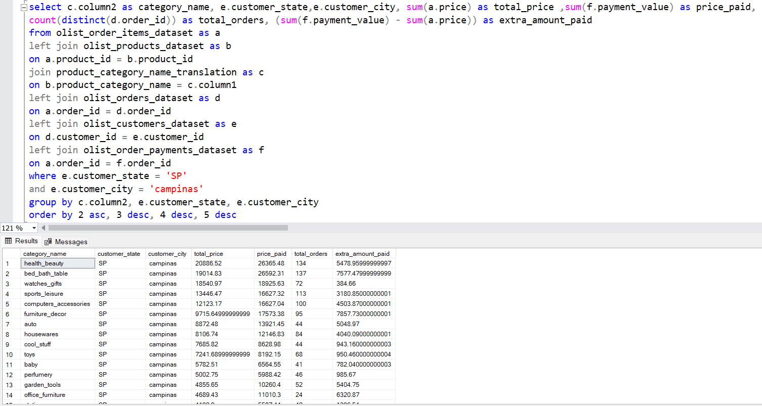
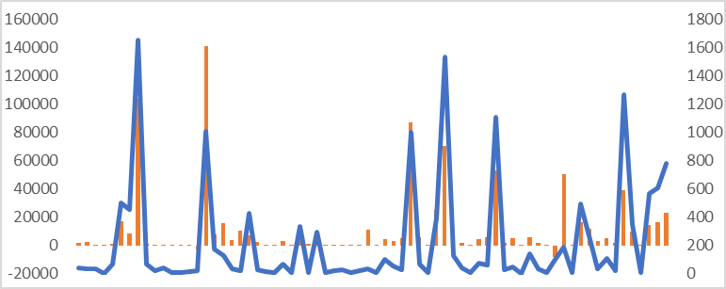
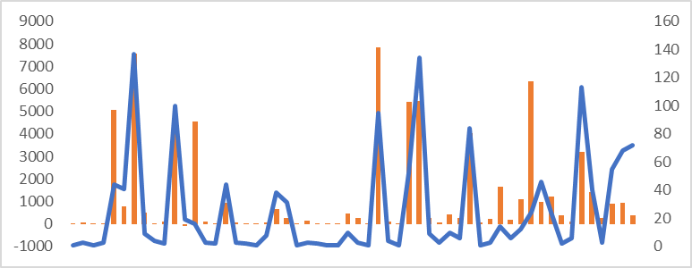
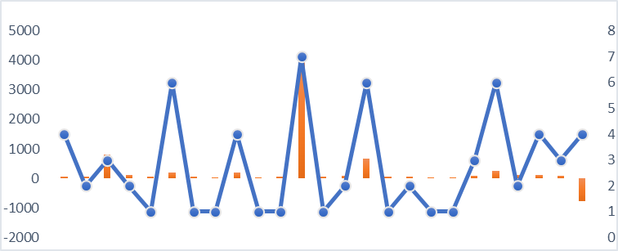
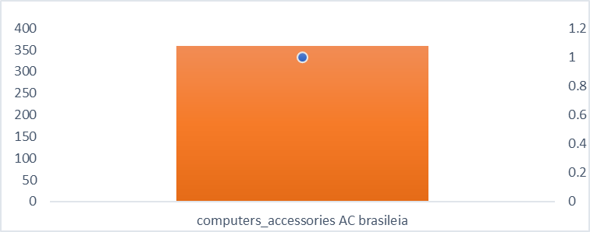
Category level sales and order placed for cities in trending states :

Slide 16
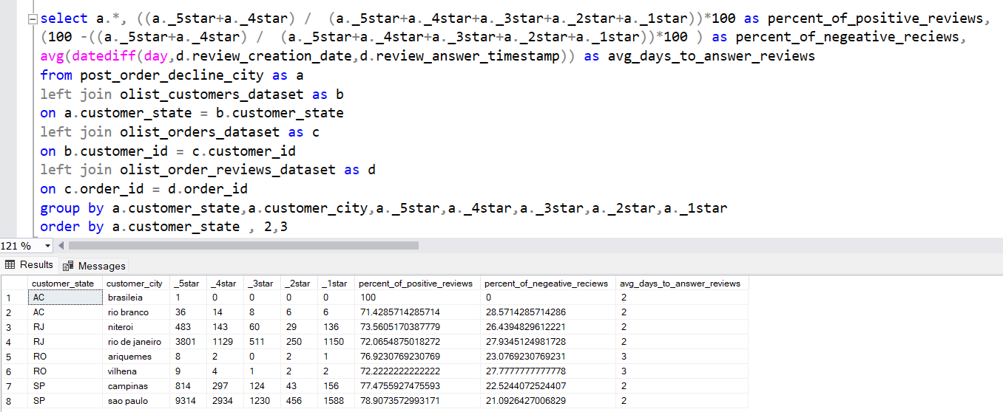
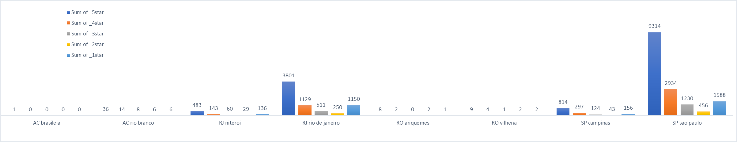
Post Order Reviews for cities causing trend in states:

Slide 17
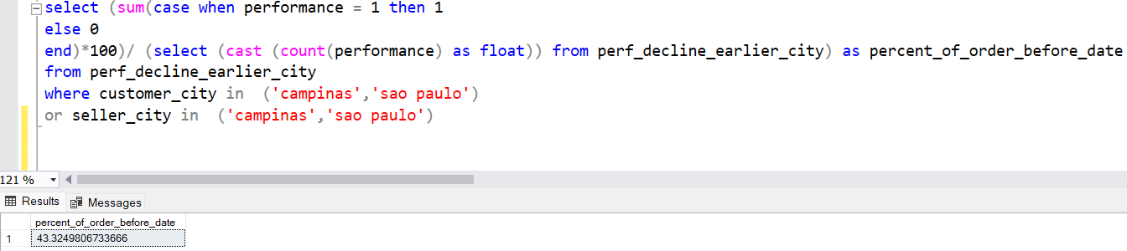



% of order delivered earlier than expected date in the top cities for trending states :

Slide 18
Findings :
In the first problem statement we can see that the trendline is somewhat similar for the different metrics i.e. our sales, customer acquisition and total no. of orders have increased in the same states and remained low on the same states.
We should increase the number of sellers in AC and RO states as they have only 1 and 2 sellers respectively. Because of that most of the orders have to be send by the sellers who live in SP and RJ.
We should also increase the variety of products that we sell in these states, as there are very selective category of products we sell here. Also in that category, a customer has not very much choice but to go with 5-6 products.
We can see that the percentage of order delivered before expected date in declining trend states is much higher, than percentage of order delivered before expected date in increasing trend states. The main reason being that a declining trend state seller has to send products only to its state, whereas the increasing trend state sellers have to deliver their products into many different states which creates problems and decrease their overall performance.

Slide 19
Findings :
On the other hand, when we see the top cities of these states, we can see that cities which come in declining trends have very low percentage of order delivered before expected date, which is why we should change the seller at those cities.
In the declining trend cities, we have very less categories available, and the type of products is also very low, we must increase them so that customers can get attracted towards our store.
We must come up with a strategy to reduce the time taken for a product delivery, as the number of days is quiet high for declining states.

Slide 20
THANK YOU

